Slide 1
Unit 16 (DEFINITIONS NOT INCLUDED)
Created by Kathy Young
www.KathyYoung.me
Based on the
Illinois STAR Vocabulary Booster
Adult Learning Resource Center, Arlington Heights, IL

Slide 2
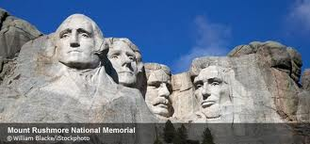
significant
Adjective
SYNONYM-

Slide 3
Priority
Noun
SYNONYM-

Slide 4
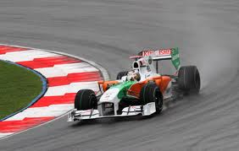
Qualify
Verb
SYNONYM-

Slide 5
Certain
Adjective
SYNONYM-

Slide 6
Duplicate
Noun
SYNONYM-

Slide 7
Advance
Adjective
SYNONYM-

Slide 8
Effective
Adjective
SYNONYM-

Slide 9
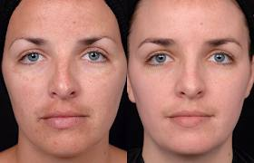
Enhance
Verb
SYNONYM-

Slide 10
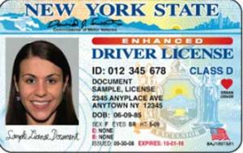
Valid
Adjective
SYNONYM-

Slide 11
Substantial
Adjective
SYNONYM-

