Slide 1
Unit 5 (Definitions Not Included)
Created by Kathy Young
www.KathyYoung.me
Based on the
Illinois STAR Vocabulary Booster
Adult Learning Resource Center, Arlington Heights, IL

Slide 2
(Unit 5) contract
Noun
SYNONYM-

Slide 3
legal
Adjective
SYNONYM-

Slide 4
environment
Noun
SYNONYM-

Slide 5
indicate
Verb
SYNONYM-

Slide 6
role
Noun
SYNONYM-

Slide 7
previous
Adjective
SYNONYM-

Slide 8
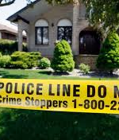
conduct
Verb
SYNONYM-

Slide 9
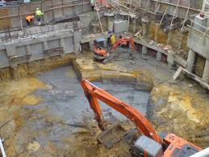
site
Noun
SYNONYM-

Slide 10
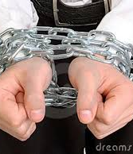
constraint
Noun
SYNONYM-

Slide 11
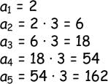
sequence
Noun
SYNONYM-

