Slide 1
Unit 10
Definitions Included
Created by Kathy Young
www.KathyYoung.me
Based on the
Illinois STAR Vocabulary Booster
Adult Learning Resource Center, Arlington Heights, IL

Slide 2
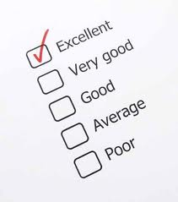
assess
To make a judgement about a person or situation after thinking carefully about it
Verb
SYNONYM - evaluate

Slide 3
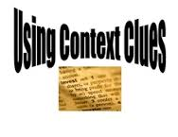
context
The situation, events, or information that relate to something and help you understand it
Noun
SYNONYM - conditions

Slide 4
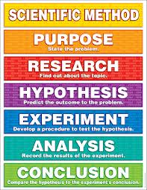
method
A planned way of doing something
Noun
SYNONYM – procedure

Slide 5

policy
A way of doing things that has been officially agreed by a political party, business or organization
Noun
SYNONYM - procedure

Slide 6

significant
Noticeable or important
Adjective
SYNONYM - meaningful

Slide 7

involve
To include or affect someone or something
Verb
SYNONYM – incorporate
ANTONYM - exclude

Slide 8
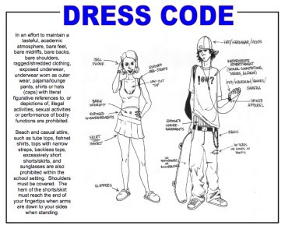
appropriate
Correct or good for a particular time, situation, or purpose
Adjective
SYNONYM - suitable
ANTONYM - improper

Slide 9
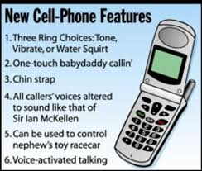
feature
An important, interesting or typical part of something
Noun
SYNONYM - characteristic

Slide 10

normal
Usual, typical or expected
Adjective
SYNONYM – standard
ANTONYM - unusual

Slide 11

relevant
Directly relating to the subject or problem being discussed
Adjective
SYNONYM – pertinent, applicable

