Slide 1
Unit 10
Definitions Not Included
Created by Kathy Young
www.KathyYoung.me
Based on the
Illinois STAR Vocabulary Booster
Adult Learning Resource Center, Arlington Heights, IL

Slide 2
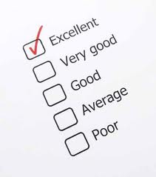
assess
Verb
SYNONYM - evaluate

Slide 3
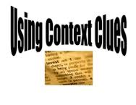
context
Noun
SYNONYM - conditions

Slide 4
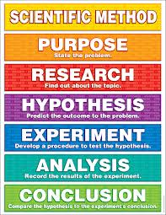
method
Noun
SYNONYM – procedure

Slide 5

policy
Noun
SYNONYM - procedure

Slide 6

significant
Adjective
SYNONYM - meaningful

Slide 7

involve
Verb
SYNONYM – incorporate
ANTONYM - exclude

Slide 8
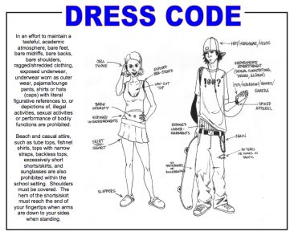
appropriate
Adjective
SYNONYM - suitable
ANTONYM - improper

Slide 9
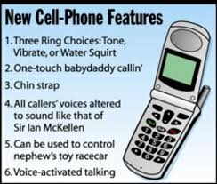
feature
Noun
SYNONYM - characteristic

Slide 10
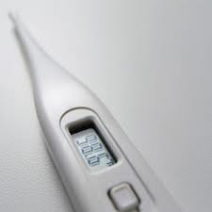
normal
Adjective
SYNONYM – standard
ANTONYM - unusual

Slide 11

relevant
Adjective
SYNONYM – pertinent, applicable

