Slide 1
Unit 11
Definitions Included
Created by Kathy Young
www.KathyYoung.me
Based on the
Illinois STAR Vocabulary Booster
Adult Learning Resource Center, Arlington Heights, IL

Slide 2
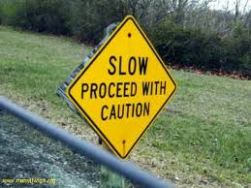
proceed
To continue as planned or to move forward
Verb
SYNONYM – advance
ANTONYM - stop

Slide 3
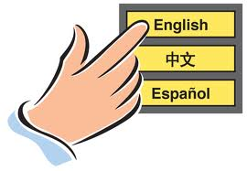
select
To choose something or someone
Verb
SYNONYM- pick (out)
ANTONYM - reject

Slide 4
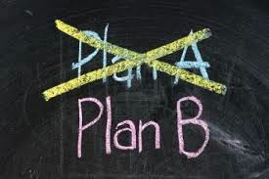
alternative
Can be used in place of something else
Adjective
SYNONYM- substitute

Slide 5

consequence
Something that happens as a result of a particular action
Noun
SYNONYM- outcome
ANTONYM - cause

Slide 6
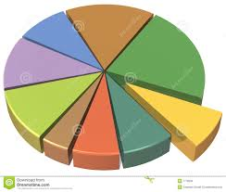
section
One of the parts that a object, group, or place is divided into
Noun
SYNONYM - portion

Slide 7

focus
To give all your attention to a particular thing
Verb
SYNONYM- concentrate on

Slide 8

rely
To depend on something or someone
Verb
SYNONYM- trust
ANTONYM - doubt

Slide 9
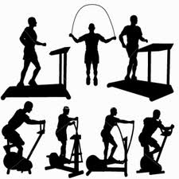
physical
Relating to someone’s body rather than his/her mind or soul
Adjective
SYNONYM-bodily
ANTYNYM - mental

Slide 10

transfer
To move from one place to another
Verb
SYNONYM - shift

Slide 11

positive
Good or useful
Adjective
SYNONYM - favorable
ANTONYM - negative

