Slide 1
Unit 11
Definitions Not Included
Created by Kathy Young
www.KathyYoung.me
Based on the
Illinois STAR Vocabulary Booster
Adult Learning Resource Center, Arlington Heights, IL

Slide 2
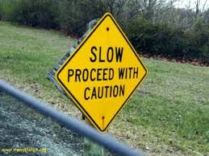
proceed
Verb
SYNONYM – advance
ANTONYM - stop

Slide 3

select
Verb
SYNONYM- pick (out)
ANTONYM - reject

Slide 4
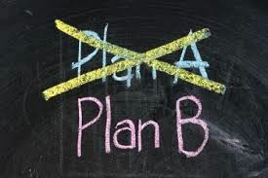
alternative
Adjective
SYNONYM- substitute

Slide 5

consequence
Noun
SYNONYM- outcome
ANTONYM - cause

Slide 6
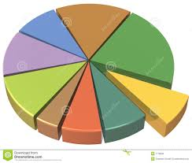
section
Noun
SYNONYM - portion

Slide 7

focus
Verb
SYNONYM- concentrate on

Slide 8

rely
Verb
SYNONYM- trust
ANTONYM - doubt

Slide 9

physical
Adjective
SYNONYM-bodily
ANTYNYM - mental

Slide 10

transfer
Verb
SYNONYM - shift

Slide 11

positive
Adjective
SYNONYM - favorable
ANTONYM - negative

