Slide 1
Unit 15
(DEFINITIONS INCLUDED)
Created by Kathy Young
www.KathyYoung.me
Based on the
Illinois STAR Vocabulary Booster
Adult Learning Resource Center, Arlington Heights, IL

Slide 2

task
A job or a particular thing you have to do, often a difficult or annoying job
Noun
SYNONYM- chore

Slide 3

specify
To state something in an exact or detailed way
Verb
SYNONYM- indicate

Slide 4
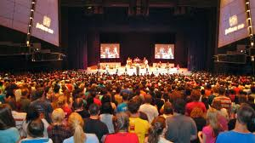
conference
A large meeting where people discuss things, usually related to work
Noun
SYNONYM- convention

Slide 5
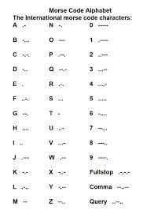
code
A system of numbers, words, or symbols that are used instead of ordinary writing
Noun
SYNONYM- cipher

Slide 6
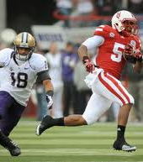
shift
To move from one place or position to another
Verb
SYNONYM- adjust

Slide 7
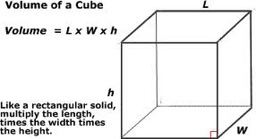
volume
The amount of space a substance fills or an object contains, or the total amount of something
Noun
SYNONYM- quantity

Slide 8
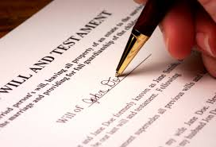
document
A piece of paper that has something official written on it
Noun
SYNONYM- Legal paper

Slide 9

approach
To move closer to someone or something
Verb
SYNONYM- Advance nearer

Slide 10

interaction
The activity of talking with other people and working together with them
Noun
SYNONYM- communication

Slide 11
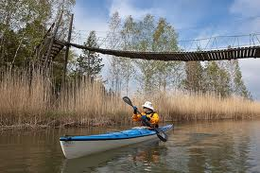
flimsy
Weak and not made very well, or lightweight
Adjective
SYNONYM- wobbly

