Slide 1
Unit 15
(DEFINITIONS NOT INCLUDED)
Created by Kathy Young
www.KathyYoung.me
Based on the
Illinois STAR Vocabulary Booster
Adult Learning Resource Center, Arlington Heights, IL

Slide 2

task
Noun
SYNONYM-

Slide 3

specify
Verb
SYNONYM-

Slide 4
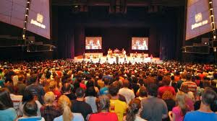
conference
Noun
SYNONYM-

Slide 5
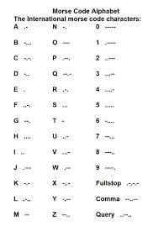
code
Noun
SYNONYM-

Slide 6
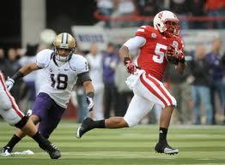
shift
Verb
SYNONYM-

Slide 7
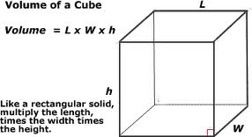
volume
Noun
SYNONYM-

Slide 8
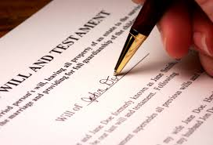
document
Noun
SYNONYM-

Slide 9

approach
Verb
SYNONYM-

Slide 10

interaction
Noun
SYNONYM-

Slide 11
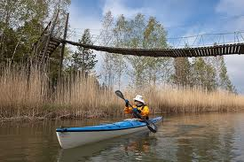
flimsy
Adjective
SYNONYM-

