Slide 1
Unit 16
(DEFINITIONS INCLUDED)
Created by Kathy Young
www.KathyYoung.me
Based on the
Illinois STAR Vocabulary Booster
Adult Learning Resource Center, Arlington Heights, IL

Slide 2
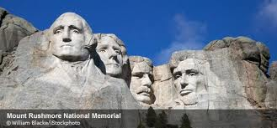
significant
Important or noticeable
Adjective
SYNONYM- meaningful

Slide 3
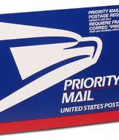
Priority
The most important thing that needs to be done first
Noun
SYNONYM- preference

Slide 4
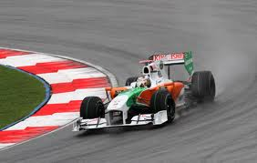
Qualify
To pass a test or reach a level of knowledge or skill that you need to do something
Verb
SYNONYM- prepared

Slide 5

Certain
A particular thing, person, or idea that is not named exactly
Adjective
SYNONYM- specific

Slide 6

Duplicate
An exact copy of something
Noun
SYNONYM- reproduction

Slide 7

Advance
Before something happens or is expected to happen
Adjective
SYNONYM- prior

Slide 8

Effective
Producing the result you wanted
Adjective
SYNONYM- successful

Slide 9
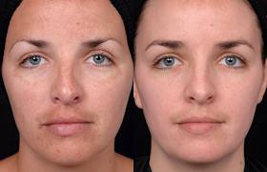
Enhance
To improve the quality or value
Verb
SYNONYM- increase

Slide 10
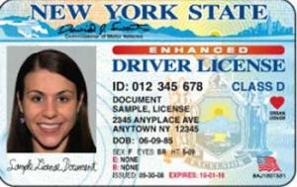
Valid
Legally acceptable or official
Adjective
SYNONYM- lawful

Slide 11

Substantial
A large amount or number
Adjective
SYNONYM- sizable

