Slide 1
Unit 17 Definitions Included
Created by Kathy Young
www.KathyYoung.me
Based on the
Illinois STAR Vocabulary Booster
Adult Learning Resource Center, Arlington Heights, IL

Slide 2
concentration
The act of thinking very carefully about something
Noun
SYNONYM – attention
ANTONYM - inattention

Slide 3
cycle
A number of related events that happen again and again in the same order
Noun
SYNONYM - series

Slide 4
contrast
A difference between people, situations, or ideas that are being compared
Noun
SYNONYM – difference
ANTONYM- similarity

Slide 5
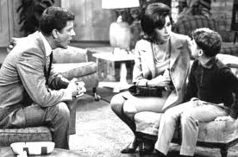
domestic
1) happening within one country and not involving any other countries
2) relating to the running of a home or family relations
Adjective
SYNONYM – 1) national
ANTONYM – 2) family

Slide 6
error
A mistake, something that is not correct
Noun
SYNONYM – blunder, inaccuracy

Slide 7
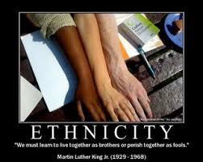
ethnic
Related to a particular race, nation, tribe, or culture
Adjective
SYNONYM – racial

Slide 8
goal
Something that you hope to achieve in the future
Noun
SYNONYM – target

Slide 9
Take something for granted
To believe that something is true without making sure
SYNONYM - assume

Slide 10
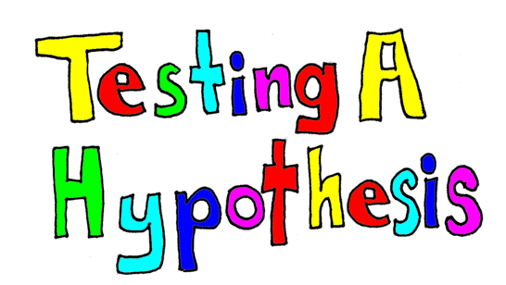
hypothesis
An explanation for something that has not been proven to be true
Noun
SYNONYM - theory

Slide 11
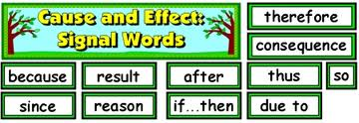
implication
The possible effect or result of a plan or action; the likely consequence of something
Noun
SYNONYM-consequence

