Slide 1
Unit 17 Definitions Not Included
Created by Kathy Young
www.KathyYoung.me
Based on the
Illinois STAR Vocabulary Booster
Adult Learning Resource Center, Arlington Heights, IL

Slide 2
concentration
Noun
SYNONYM – attention
ANTONYM - inattention

Slide 3
cycle
Noun
SYNONYM - series

Slide 4
contrast
Noun
SYNONYM – difference
ANTONYM- similarity

Slide 5
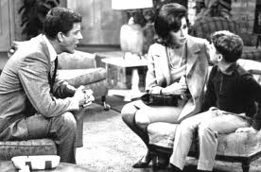
domestic
Adjective
SYNONYM – 1) national
ANTONYM – 2) family

Slide 6
error
Noun
SYNONYM – blunder, inaccuracy

Slide 7
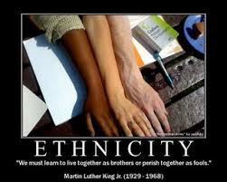
ethnic
Adjective
SYNONYM – racial

Slide 8
goal
Noun
SYNONYM – target

Slide 9
Take something for granted
SYNONYM - assume

Slide 10
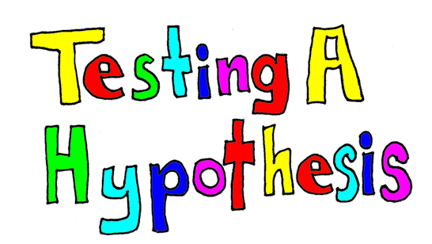
hypothesis
Noun
SYNONYM - theory

Slide 11
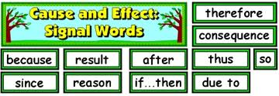
implication
Noun
SYNONYM-consequence

