Slide 1
Unit 18
Definitions Included
Created by Kathy Young
www.KathyYoung.me
Based on the
Illinois STAR Vocabulary Booster
Adult Learning Resource Center, Arlington Heights, IL

Slide 2
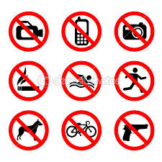
prohibit
To say that an action is illegal or not allowed
VERB
SYNONYM-forbid
ANTONYM-permit

Slide 3

detrimental
Harmful or damaging
ADJECTIVE
SYNONYM-destructive
ANTONYM-beneficial

Slide 4

default
The standard way things are arranged on a computer screen or program unless you change them
NOUN
SYNONYM-standard setting

Slide 5
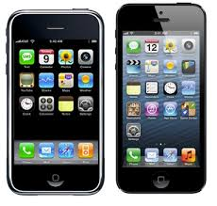
feature
An interesting or important part or ability
NOUN
SYNONYM-components or characteristics

Slide 6

spontaneous
Done or said in a natural way without planning it
ADJECTIVE
SYNONYM-unrehearsed
ANTONYM-calculated

Slide 7
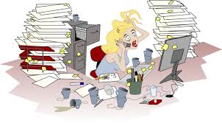
hectic
Very busy
ADJECTIVE
SYNONYM-frantic
ANTONYM-leisurely

Slide 8
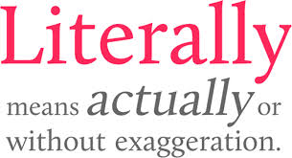
literally
In a way that uses the ordinary, true meaning of the word
ADVERB
SYNONYM-exactly

Slide 9

(biggest) bang for a buck
Best result, the biggest effect
NOUN
SYNONYM-best outcome

Slide 10
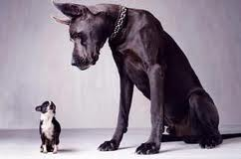
intimidate
To make someone feel afraid or to threaten
VERB
SYNONYM-terrorize

Slide 11

violate
To do something that is against a law or rule
VERB
SYNONYM-disobey
ANTONYM-comply with

