Slide 1
Unit 18
Definitions Not Included
Created by Kathy Young
www.KathyYoung.me
Based on the
Illinois STAR Vocabulary Booster
Adult Learning Resource Center, Arlington Heights, IL

Slide 2

prohibit
VERB
SYNONYM-forbid
ANTONYM-permit

Slide 3

detrimental
ADJECTIVE
SYNONYM-destructive
ANTONYM-beneficial

Slide 4

default
NOUN
SYNONYM-standard setting

Slide 5
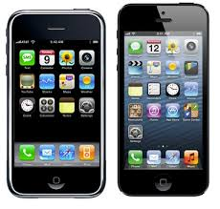
feature
NOUN
SYNONYM-components or characteristics

Slide 6

spontaneous
ADJECTIVE
SYNONYM-unrehearsed
ANTONYM-calculated

Slide 7
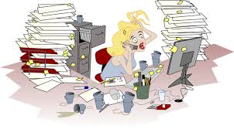
hectic
ADJECTIVE
SYNONYM-frantic
ANTONYM-leisurely

Slide 8
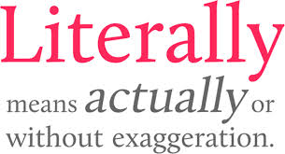
literally
ADVERB
SYNONYM-exactly

Slide 9

(biggest) bang for a buck
NOUN
SYNONYM-best outcome

Slide 10
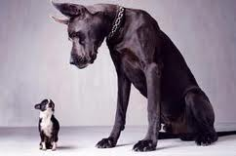
intimidate
VERB
SYNONYM-terrorize

Slide 11

violate
VERB
SYNONYM-disobey
ANTONYM-comply with

