Slide 1
Unit 19
Definitions Included
Created by Kathy Young
www.kathyyoung.me
Based on the
Illinois STAR Vocabulary Booster
Adult Learning Resource Center, Arlington Heights, IL

Slide 2
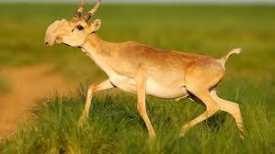
bizarre
Strange, odd, unusual
ADJECTIVE
SYNONYM-peculiar
ANTONYM-usual

Slide 3

strive
To try very hard to do something
VERB
SYNONYM-attempt

Slide 4

forbidden
Not allowed, prohibited
ADJECTIVE
SYNONYM-outlawed
ANTONYM-permitted

Slide 5
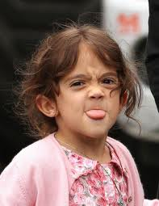
sassy
To be rude to someone you should respect
ADJECTIVE
SYNONYM-bold or discourteous

Slide 6

resilient
Able to quickly become strong, healthy, or happy after a difficult situation
ADJECTIVE
SYNONYM-hardy or irrepressible

Slide 7
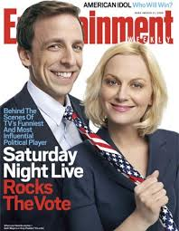
satire
A way of talking or writing about something that is funny
NOUN
SYNONYM-parody

Slide 8
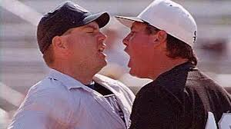
retort
To reply quickly, in an angry or humorous way
VERB
SYNONYM-respond

Slide 9

geek
Someone who is very focused on one special area and who is not aware of other things
NOUN
SYNONYM-expert

Slide 10

wise
Based on good judgment and experience
ADJECTIVE
SYNONYM-intelligent
ANTONYM-foolish

Slide 11
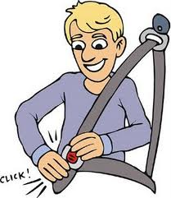
restrain
To hold back, to keep someone or something under control
VERB
SYNONYM-prevent
ANTONYM-release

