Slide 1
Unit 19
Definitions Not Included
Created by Kathy Young
www.kathyyoung.me
Based on the
Illinois STAR Vocabulary Booster
Adult Learning Resource Center, Arlington Heights, IL

Slide 2
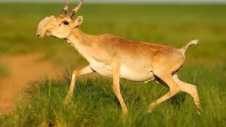
bizarre
ADJECTIVE
SYNONYM-peculiar
ANTONYM-usual

Slide 3

strive
VERB
SYNONYM-attempt

Slide 4

forbidden
ADJECTIVE
SYNONYM-outlawed
ANTONYM-permitted

Slide 5
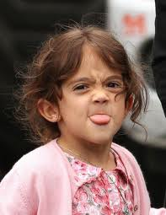
sassy
ADJECTIVE
SYNONYM-bold or discourteous

Slide 6

resilient
ADJECTIVE
SYNONYM-hardy or irrepressible

Slide 7
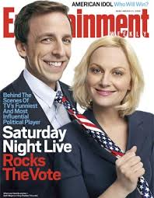
satire
NOUN
SYNONYM-parody

Slide 8
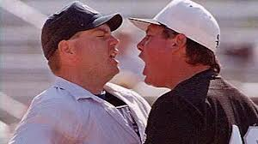
retort
VERB
SYNONYM-respond

Slide 9

geek
NOUN
SYNONYM-expert

Slide 10

wise
ADJECTIVE
SYNONYM-intelligent
ANTONYM-foolish

Slide 11

restrain
VERB
SYNONYM-prevent
ANTONYM-release

