Slide 1
Unit 1
(Definitions Included)
Created by Kathy Young
www.KathyYoung.me
Based on the
Illinois STAR Vocabulary Booster
Adult Learning Resource Center, Arlington Heights, IL

Slide 2
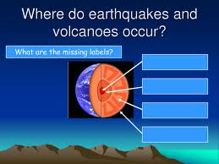
(Unit 1) occur
To happen especially without being planned first
Verb
SYNONYM- happen

Slide 3

potential
Likely to develop in the future
Adjective
SYNONYM- possible

Slide 4
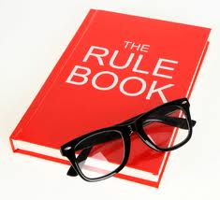
regulation
An official rule or order
Noun
SYNONYM- law

Slide 5
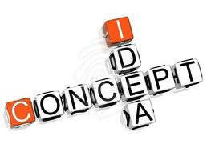
concept
An idea of how something is or how something should be done
Noun
SYNONYM- idea

Slide 6

major
Very large or important
Adjective
SYNONYM- significant

Slide 7
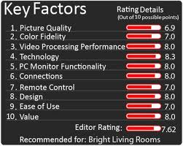
factor
A thing that influences or causes a situation
Noun
SYNONYM- consideration

Slide 8

achieve
To succeed in getting a good result or in doing something you want
Verb
SYNONYM- accomplish

Slide 9

instance
An example
Noun
SYNONYM- case

Slide 10
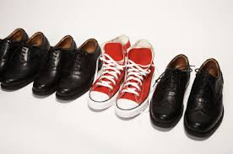
distinction
A clear difference between things
Noun
SYNONYM- contrast

Slide 11

initial
Happening at the beginning
Adjective
SYNONYM- first

