Slide 1
Unit 1
(Definitions Not Included)
Created by Kathy Young
www.KathyYoung.me
Based on the
Illinois STAR Vocabulary Booster
Adult Learning Resource Center, Arlington Heights, IL

Slide 2
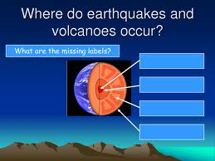
(Unit 1) occur
Verb
SYNONYM-

Slide 3

potential
Adjective
SYNONYM-

Slide 4

regulation
Noun
SYNONYM-

Slide 5

concept
Noun
SYNONYM-

Slide 6

major
Adjective
SYNONYM-

Slide 7
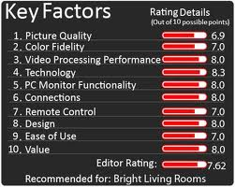
factor
Noun
SYNONYM-

Slide 8

achieve
Verb
SYNONYM-

Slide 9

instance
Noun
SYNONYM-

Slide 10
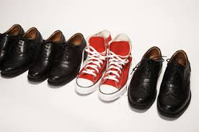
distinction
Noun
SYNONYM-

Slide 11

initial
Adjective
SYNONYM-

