Slide 1
Unit 2
(Definitions Included)
Created by Kathy Young
www.KathyYoung.me
Based on the
Illinois STAR Vocabulary Booster
Adult Learning Resource Center, Arlington Heights, IL

Slide 2
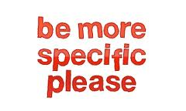
(Unit 2) specific
Detailed and exact
Adjective
SYNONYM- particular

Slide 3

principle
A moral rule or set of ideas about what is right or wrong that influences how you behave
Noun
SYNONYM- belief

Slide 4
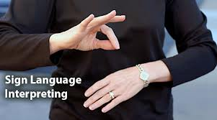
interpretation
An explanation for an event or someone’s actions
Noun
SYNONYM- explanation

Slide 5

assume
To think something is true when you have no proof
Verb
SYNONYM- conclude

Slide 6
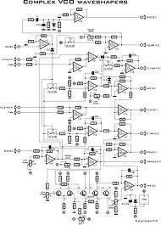
complex
Has a lot of parts and is difficult to understand
Adjective
SYNONYM- elaborate

Slide 7

identify
To recognize and name someone or something
Verb
SYNONYM- pinpoint

Slide 8
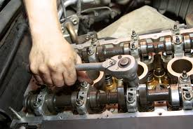
maintenance
The work necessary to keep something in good condition
Noun
SYNONYM- upkeep

Slide 9

sought
Past tense and past participle of the verb “to seek”; tried to find and get something
Verb
SYNONYM- searched for

Slide 10

imply
To suggest something is true without saying or showing it directly
Verb
SYNONYM- hint

Slide 11
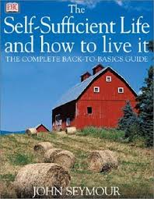
sufficient
As much as you need for a particular purpose
Adjective
SYNONYM- adequate

