Slide 1
Unit 2
(Definitions Not Included)
Created by Kathy Young
www.KathyYoung.me
Based on the
Illinois STAR Vocabulary Booster
Adult Learning Resource Center, Arlington Heights, IL

Slide 2
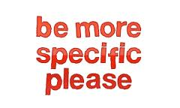
(Unit 2) specific
Adjective
SYNONYM-

Slide 3

principle
Noun
SYNONYM-

Slide 4
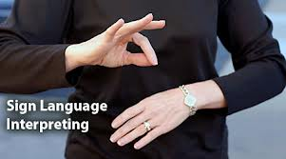
interpretation
Noun
SYNONYM-

Slide 5

assume
Verb
SYNONYM-

Slide 6
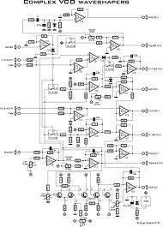
complex
Adjective
SYNONYM-

Slide 7

identify
Verb
SYNONYM-

Slide 8
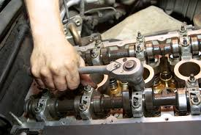
maintenance
Noun
SYNONYM-

Slide 9

sought
Verb
SYNONYM-

Slide 10

imply
Verb
SYNONYM-

Slide 11
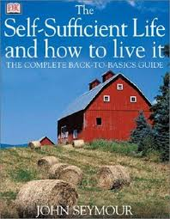
sufficient
Adjective
SYNONYM-

