Slide 1
Unit 3 (Definitions Included)
Created by Kathy Young
www.KathyYoung.me
Based on the
Illinois STAR Vocabulary Booster
Adult Learning Resource Center, Arlington Heights, IL

Slide 2
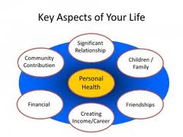
(Unit 3) aspect
One part of a situation, plan or subject
Noun
SYNONYM- characteristic

Slide 3
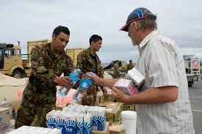
distribute
To give something such as food or medicine to each person in a large group
Verb
SYNONYM- deliver

Slide 4
establish
To start something such as a company or a group
Verb
SYNONYM- create

Slide 5
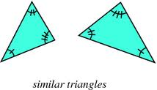
similar
Almost the same but not identical
Adjective
SYNONYM- alike

Slide 6
analysis
The careful examination of something in order to understand it better
Noun
SYNONYM- examination

Slide 7
perceive
To understand or think about something in a particular way
Verb
SYNONYM- consider

Slide 8
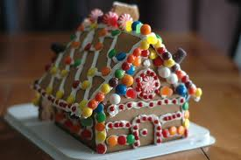
tradition
Something people have done for a long time and continue to do
Noun
SYNONYM- ritual

Slide 9
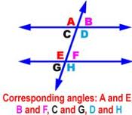
correspond
If two things correspond, they are similar to each other or relate to each other
Verb
SYNONYM- coincide

Slide 10
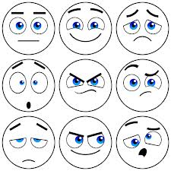
reaction
Something you do in response to something that has happened
Noun
SYNONYM- response

Slide 11
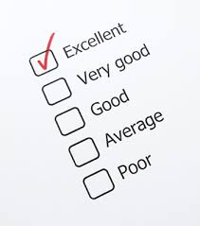
evaluate
To judge how good, useful, or successful someone or something is
Verb
SYNONYM- assess

