Slide 1
Unit 3
(Definitions Not Included)
Created by Kathy Young
www.KathyYoung.me
Based on the
Illinois STAR Vocabulary Booster
Adult Learning Resource Center, Arlington Heights, IL

Slide 2
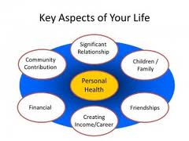
(Unit 3) aspect
Noun
SYNONYM-

Slide 3
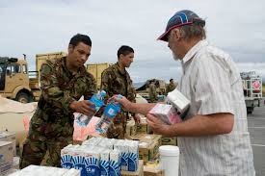
distribute
Verb
SYNONYM-

Slide 4

establish
Verb
SYNONYM-

Slide 5
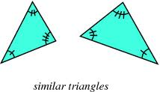
similar
Adjective
SYNONYM-

Slide 6

analysis
Noun
SYNONYM-

Slide 7

perceive
Verb
SYNONYM-

Slide 8
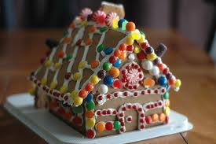
tradition
Noun
SYNONYM-

Slide 9
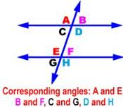
correspond
Verb
SYNONYM-

Slide 10
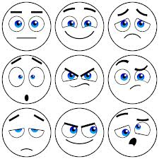
reaction
Noun
SYNONYM-

Slide 11
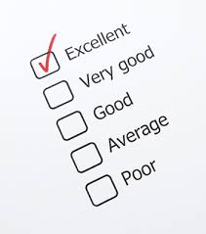
evaluate
Verb
SYNONYM-

