Slide 1
Unit 4 (Definitions included)
Created by Kathy Young
www.KathyYoung.me
Based on the
Illinois STAR Vocabulary Booster
Adult Learning Resource Center, Arlington Heights, IL

Slide 2
(Unit 4) technique
A special way of doing something
Noun
SYNONYM- method

Slide 3
emphasis
Special importance
Noun
SYNONYM- attention

Slide 4
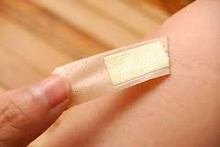
remove
Take something away
Verb
SYNONYM- transfer

Slide 5
negative
Bad or harmful
Adjective
SYNONYM- critical

Slide 6
consent
Permission to do something
Noun
SYNONYM- authorization

Slide 7
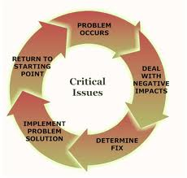
issue
A subject or problem people discuss
Noun
SYNONYM- topic

Slide 8
available
You can have it, buy it, or use it
Adjective
SYNONYM- accessible

Slide 9
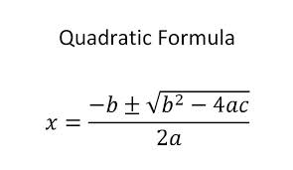
formula
A method that you use to solve a problem or make sure something is successful
Noun
SYNONYM- procedure

Slide 10
area
A particular part of a place, city, or country, etc.
Noun
SYNONYM- region

Slide 11
research
To study a subject in detail in order to discover new facts about it
Verb
SYNONYM- investigate

