Slide 1
Unit 4 (Definitions Not Included)
Created by Kathy Young
www.KathyYoung.me
Based on the
Illinois STAR Vocabulary Booster
Adult Learning Resource Center, Arlington Heights, IL

Slide 2
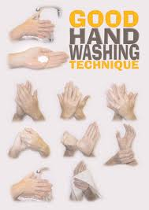
(Unit 4) technique
Noun
SYNONYM-

Slide 3
emphasis
Noun
SYNONYM-

Slide 4
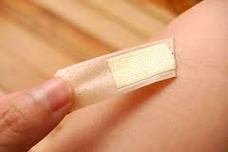
remove
Verb
SYNONYM-

Slide 5
negative
Adjective
SYNONYM-

Slide 6
consent
Noun
SYNONYM-

Slide 7
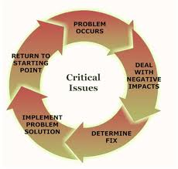
issue
Noun
SYNONYM-

Slide 8
available
Adjective
SYNONYM-

Slide 9
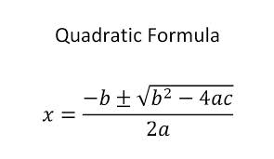
formula
Noun
SYNONYM-

Slide 10
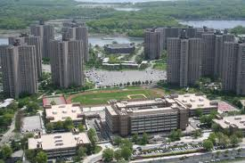
area
Noun
SYNONYM-

Slide 11
research
Verb
SYNONYM-

