Slide 1
UNIT 5 (Definitions Included)
Created by Kathy Young
www.KathyYoung.me
Based on the
Illinois STAR Vocabulary Booster
Adult Learning Resource Center, Arlington Heights, IL

Slide 2
(Unit 5) contract
A legal written agreement between two people or two companies
Noun
SYNONYM- arrangement

Slide 3
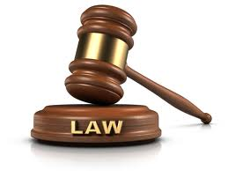
legal
Allowed, ordered, or approved by law
Adjective
SYNONYM- authorized

Slide 4
environment
The land, water and air in which people, animals, and plants live
Noun
SYNONYM- surroundings

Slide 5
indicate
To show something that something exists or is likely to be true
Verb
SYNONYM- demonstrate

Slide 6
role
Position, job, or function a person has
Noun
SYNONYM- job

Slide 7
previous
Happening before a particular event or time
Adjective
SYNONYM- former

Slide 8
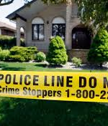
conduct
To do something in an organized way to get information to prove facts
Verb
SYNONYM- supervise

Slide 9
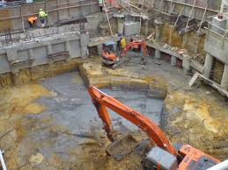
site
A place where something important or interesting happened
Noun
SYNONYM- location

Slide 10
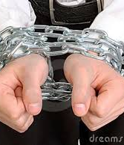
constraint
Something that constricts what you are doing
Noun
SYNONYM- limitation

Slide 11
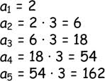
sequence
The order that things are supposed to be in or be done
Noun
SYNONYM- series

