Slide 1
UNIT 6
(Definitions included)
Created by Kathy Young
www.KathyYoung.me
Based on the
Illinois STAR Vocabulary Booster
Adult Learning Resource Center, Arlington Heights, IL

Slide 2
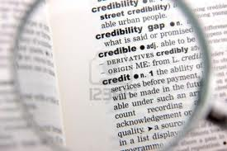
(Unit 6) definition
A phrase or a word that says exactly what a word means
Noun
SYNONYM- description

Slide 3
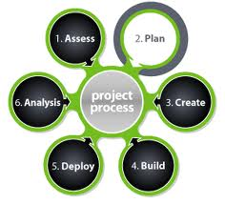
process
A series of actions that someone does to achieve a particular result
Noun
SYNONYM- method

Slide 4

item
A single thing in a set, group, or list
Noun
SYNONYM- object

Slide 5

period
A length of time
Noun
SYNONYM- interval

Slide 6

evidence
Facts, objects, or signs that show that something exists or is true
Noun
SYNONYM- proof

Slide 7

primary
Most important or essential
Adjective
SYNONYM- main

Slide 8

estimate
To judge the value or size of something
Verb
SYNONYM- calculate

Slide 9
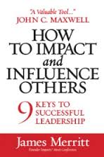
impact
The effect that an event or situation has on someone or something
Noun
SYNONYM- consequences

Slide 10
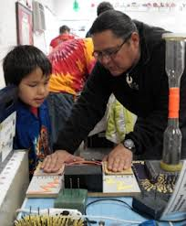
demonstrate
To show how to use or do something
Verb
SYNONYM- indicate

Slide 11
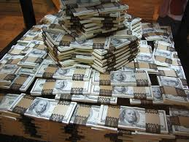
considerable
Large enough to be important or have an effect
Adjective
SYNONYM- significant

