Slide 1
Unit 6 (Definitions Not Included)
Created by Kathy Young
www.KathyYoung.me
Based on the
Illinois STAR Vocabulary Booster
Adult Learning Resource Center, Arlington Heights, IL

Slide 2
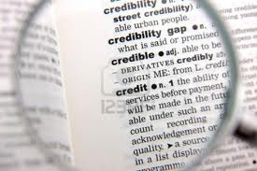
(Unit 6) definition
Noun
SYNONYM-

Slide 3
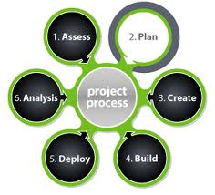
process
Noun
SYNONYM-

Slide 4
item
Noun
SYNONYM-

Slide 5
period
Noun
SYNONYM-

Slide 6
evidence
Noun
SYNONYM-

Slide 7
primary
Adjective
SYNONYM-

Slide 8
estimate
Verb
SYNONYM-

Slide 9
impact
Noun
SYNONYM-

Slide 10
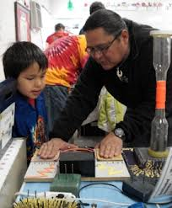
demonstrate
Verb
SYNONYM-

Slide 11
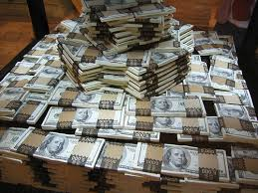
considerable
Adjective
SYNONYM-

