Slide 1
Unit 8 Definitions Included
Created by
Kathy Young

Slide 2
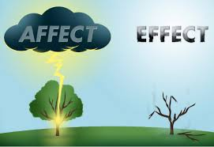
affect
To do something that produces a change in something
Verb
SYNONYM-influence

Slide 3
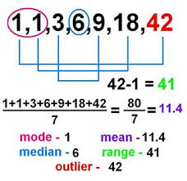
range
A number of people or things that are different but belong to the same type
Noun
SYNONYM-assortment

Slide 4
restricted
Controlled or regulated
Adjective
SYNONYM-limited

Slide 5
conclusion
Something that is decided after considering all the information
Noun
SYNONYM-ending

Slide 6
benefit
An advantage, improvement, or help that you get from something
Noun
SYNONYM-reward

Slide 7
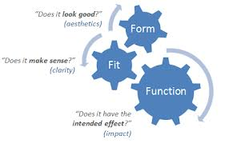
function
The usual purpose of a thing, or the job that someone usually does
Noun
SYNYNYM-use

Slide 8
source
The thing, place, or person that you get something from
Noun
SYNONYM-origin

Slide 9
approach
A way of doing something or dealing with a problem
Noun
SYNONYM-technique

Slide 10
individual
Considered separately from other people or things in the same group
Adjective
SYNONYM-single

Slide 11
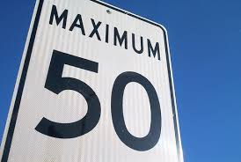
maximum
The largest amount that is possible or allowed
Adjective
SYNONYM-highest

