Slide 1
Unit 8 Definitions Not Included
Created by
Kathy Young

Slide 2
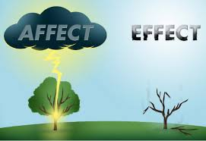
affect
Verb
SYNONYM-

Slide 3
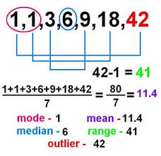
range
Noun
SYNONYM-

Slide 4
restricted
Adjective
SYNONYM-

Slide 5
conclusion
Noun
SYNONYM

Slide 6
benefit
Noun
SYNONYM-

Slide 7
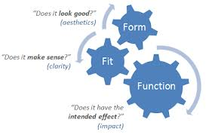
function
Noun
SYNYNYM-

Slide 8
source
Noun
SYNONYM-

Slide 9
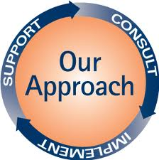
approach
Noun
SYNONYM-

Slide 10
individual
Adjective
SYNONYM-

Slide 11
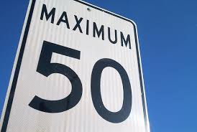
maximum
Adjective
SYNONYM-

