Slide 1
Unit 9
Definitions Included
Created by
Kathy Young

Slide 2

create
To make something new
Verb
SYNONYM-invent
ANTONYM-destroy

Slide 3

authority
The power someone has because they have an official position
Noun
SYNONYM-power

Slide 4
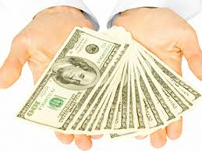
income
The money that you earn
Noun
SYNONYM-earnings
ANTONYM-expenses

Slide 5

response
An answer or a reply
Noun
SYNONYM-reaction
ANTONYM-question

Slide 6
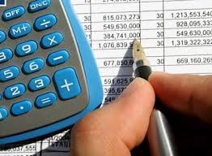
Financial
Relating to money or managing money
Adjective
SYNONYM-economic

Slide 7
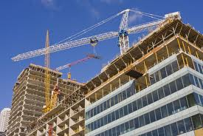
construction
The process of building something large
Noun
SYNONYM-creation
ANTONYM-destruction

Slide 8
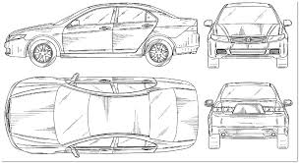
design
To make a plan or a drawing of something that you will make
Verb
SYNONYM-outline

Slide 9

obtain
To get something that you want
Verb
SYNYNYM-get
ANTONYM-lose

Slide 10

injury
Harm or damage that is done to your body
Noun
SYNONYM-wound

Slide 11
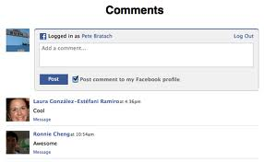
comment
An opinion that you give about something or someone
Noun
SYNONYM-criticism

