Slide 1
Unit 9
Definitions Not Included
Created by
Kathy Young

Slide 2

create
Verb
SYNONYM-
ANTONYM-destroy

Slide 3

authority
Noun
SYNONYM-

Slide 4

income
Noun
SYNONYM-
ANTONYM-expenses

Slide 5

response
Noun
SYNONYM-
ANTONYM-question

Slide 6
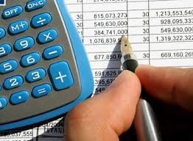
Financial
Adjective
SYNONYM-

Slide 7
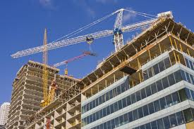
construction
Noun
SYNONYM-
ANTONYM-destruction

Slide 8
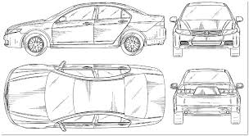
design
Verb
SYNONYM-

Slide 9

obtain
Verb
SYNYNYM-
ANTONYM-lose

Slide 10

injury
Noun
SYNONYM-

Slide 11
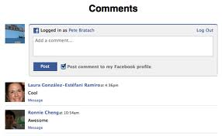
comment
Noun
SYNONYM-

